Slide 1

Polynomial Regression Using Python
Notes:
1

Slide 2


Course Code : CCE 312
Course Title : Numerical Methods
Name : Mohammed Sakib Hasan
Id : 2102052
Reg. No : 10179
Date : 27 Nov, 2025
Notes:
2

Slide 3
Introduction to Numerical Methods
What Are They?
Why Are They Important?
Numerical methods are techniques used to approximate mathematical problems, especially those that are difficult or impossible to solve analytically. They provide practical solutions for complex engineering and scientific challenges.
In engineering and science, these methods are crucial for simulating physical systems, optimising designs, and analysing data. They bridge the gap between theoretical models and real-world applications.
Key Techniques
Curve Fitting & Regression
The field encompasses various techniques, including root-finding, integration, differentiation, and solving differential equations. Each method offers a unique approach to different types of problems.
These methods are fundamental for modelling relationships between variables from observed data, allowing us to predict future outcomes or understand underlying trends. They form the basis of predictive analytics.
Notes:
3

Slide 4

What is Regression?
Definition & Purpose
Regression analysis is a statistical method used to estimate the relationships between a dependent variable and one or more independent variables. Its primary goal is to understand how the typical value of the dependent variable changes when any one of the independent variables is varied, while the other independent variables are held fixed.
Curve Fitting: Modelling the underlying pattern in data.
Prediction: Forecasting future values based on past data.
Estimation: Quantifying relationships between variables.
Notes:
4

Slide 5

What is Polynomial Regression?
Concept & Intuition
Polynomial regression extends linear regression by allowing the model to fit a curved line through the data points. Instead of fitting a straight line, it fits a polynomial function, which can capture more complex relationships between variables.
This method is particularly useful when the data clearly exhibits a curvilinear trend, which a simple straight line would fail to represent accurately. It transforms the original features into their polynomial terms (e.g., x, x^2, x^3), effectively turning a non-linear problem into a linear one in terms of coefficients.
Why Use Polynomials?
Capturing Nonlinear Patterns
Improved Accuracy
Examples of Nonlinear Patterns
1
Notes:
5

Slide 6
Mathematical Model
General Polynomial Equation
1
2
3
Coefficients (a_i)
Degree of Polynomial (n)
Least Squares Formulation
These are the unknown parameters that the regression model estimates. Each coefficient determines the weight or influence of its corresponding polynomial term on the dependent variable y.
The highest power of the independent variable x. The degree dictates the flexibility and complexity of the curve. A higher degree allows for more bends but also increases the risk of overfitting.
The coefficients are typically found by minimising the sum of the squared differences between the observed values (y) and the values predicted by the polynomial model (\hat{y}). This is known as the Least Squares method.
Notes:
6

Slide 7




Least Squares Method
Error Definition
The error, or residual, for each data point is the vertical distance between the observed actual value (y_i) and the value predicted by our regression line (\hat{y}_i). Formally, e_i = y_i - \hat{y}_i.
Sum of Squared Residuals (SSR)
To quantify the overall fit of the model, we calculate the Sum of Squared Residuals. This involves squaring each error term to ensure positive values and then summing them up. This penalises larger errors more heavily.
where m is the number of data points.
Notes:
7

Slide 8


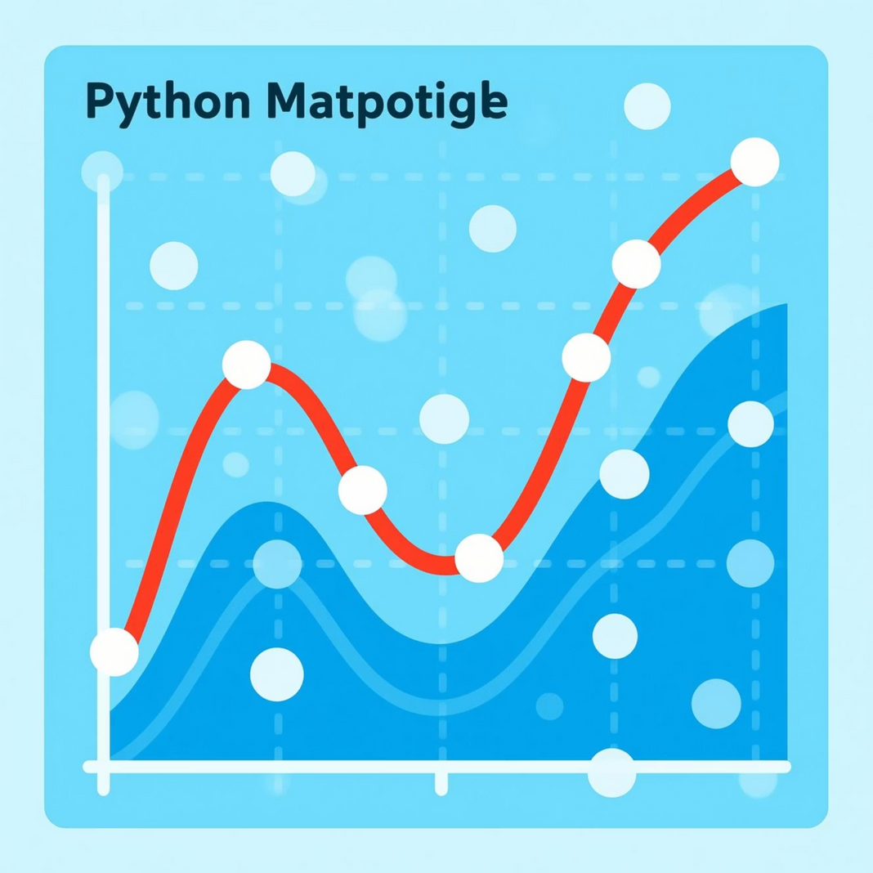
Python Implementation (NumPy)
NumPy provides convenient functions for polynomial fitting, making it straightforward to apply polynomial regression without needing to construct the design matrix manually.
numpy.polyfit()
numpy.poly1d()
This function computes the coefficients of a polynomial of a specified degree that is the best fit to the input data in a least-squares sense. It returns an array of coefficients, with the highest power first.
This class helps in creating a one-dimensional polynomial object from a set of coefficients. It makes it easy to evaluate the polynomial at specific points, much like a mathematical function.
Example Dataset & Plotting
import numpy as np
import matplotlib.pyplot as plt
# Example Datax_data = np.array([1, 2, 3, 4, 5, 6, 7, 8, 9, 10])
y_data = np.array([1, 4, 9, 16, 25, 36, 49, 64, 81, 100])
# Fit a 2nd degree
polynomialcoefficients = np.polyfit(x_data, y_data,
2)poly_model = np.poly1d(coefficients)
# Generate points for the fitted
curvex_fit = np.linspace(min(x_data), max(x_data), 100)
y_fit = poly_model(x_fit)
# Plot the resultsplt.scatter(x_data, y_data,
label='Original Data')plt.plot(x_fit, y_fit, color='red', label='Fitted Polynomial’)
plt.title('Polynomial Regression with NumPy’)
plt.xlabel('X-axis’)
plt.ylabel('Y-axis’)
plt.legend()
plt.grid(True)
plt.show()
Notes:
8

Slide 9
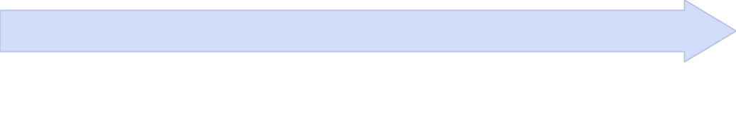

Python Implementation (Scikit-Learn)
Scikit-learn, a robust machine learning library, provides a more structured approach to polynomial regression by integrating with its linear model functionalities.
PolynomialFeatures
Prepare Data
This transformer generates new features by raising the existing features to specified polynomial degrees. It creates an expanded feature matrix including 1, x, x^2, \ldots, x^n.
Organise your independent variable(s) (X) and dependent variable (y) into appropriate NumPy array or Pandas DataFrame formats. Ensure X is reshaped into a 2D array if it's a single feature.
Predict Values
LinearRegression
Once the model is trained, use its predict() method to obtain predicted y values for new or existing X data, which can then be used for evaluation or plotting.
After transforming the features, apply Scikit-learn's LinearRegression model. This model will treat the polynomial features as independent variables and fit a linear model to them, effectively performing polynomial regression.
Notes:
9

Slide 10
Code Example: Scikit-Learn Polynomial Regression
Here's a complete Python script demonstrating polynomial regression using Scikit-learn. This example fits a degree-2 polynomial to a simple dataset.
import numpy as np
import matplotlib.pyplot as plt
from sklearn.preprocessing import PolynomialFeatures
from sklearn.linear_model import LinearRegression
# Sample datax = np.array([1, 2, 3, 4, 5, 6, 7, 8, 9, 10]).reshape(-1, 1)
y = np.array([2, 5, 7, 8, 10, 13, 17, 22, 28, 35])
# Create PolynomialFeatures object (degree 2)
poly = PolynomialFeatures(degree=2)
X_poly = poly.fit_transform(x)
# Create and fit a Linear Regression model
model = LinearRegression()model.fit(X_poly, y)
# Predict valuesy_pred = model.predict(X_poly)
Plotting the resultsplt.scatter(x, y, label='Original Data’)
plt.plot(x, y_pred, color='red', label='Polynomial Fit (Degree 2)’)
plt.title("Polynomial Regression Fit with Scikit-Learn")
plt.xlabel("X Value")
plt.ylabel("Y Value")
plt.legend()
plt.grid(True)
plt.show()
Notes:
10

Slide 11
Choosing the Polynomial Degree
Selecting the right polynomial degree is one of the most critical decisions in polynomial regression. An incorrect choice can lead to models that either fail to capture patterns or memorize noise.
How Degree Affects the Model
Underfitting (Low Degree)
Optimal Fit (Right Degree)
Overfitting (High Degree)
A model that is too simple (low degree) fails to capture the underlying structure of the data. It results in high error on both training and unseen data, indicating it has "missed" the true patterns.
This is the sweet spot where the model complexity matches the complexity of the data. It captures the true underlying relationship, leading to good performance on both training and new data.
A model that is too complex (high degree) learns the training data too well, including its noise. It performs exceptionally on training data but poorly on new, unseen data because it cannot generalize.
Bias-Variance Tradeoff
The choice of polynomial degree directly impacts the bias-variance tradeoff, a core concept in machine learning model evaluation.
High Bias, Low Variance
Balanced Tradeoff
Low Bias, High Variance
Occurs with low-degree models (underfitting). The model is too rigid, making strong assumptions about the data that are often incorrect. It consistently misses the target but is very stable (low variance).
Achieved with an optimal degree. The model is complex enough to capture the signal, but not so complex that it starts fitting to noise. This results in the best balance between predictive accuracy and generalization.
Seen in high-degree models (overfitting). The model is too flexible, fitting closely to the training data, including random fluctuations. While it might hit the training target, it's highly unstable and performs poorly on new data.
Error vs. Polynomial Degree
This diagram illustrates how training error and validation error typically behave as the polynomial degree (model complexity) increases, highlighting the zones of underfitting, optimal fit, and overfitting.
Overfitting
Optimal Fit
Underfitting
Notes:
11

Slide 12




Applications of Polynomial Regression
Polynomial regression is a versatile tool used across numerous disciplines to model complex, non-linear relationships in data. Its ability to capture curves and fluctuations makes it invaluable where simple linear models fall short.
Engineering & Materials Science
Physics & Motion Studies
Used to model non-linear responses of materials under various conditions. Examples include predicting material behavior curves, analyzing stress-strain relationships, and understanding material properties at different temperatures or loads.
Essential for describing trajectories and dynamic systems. It helps in modeling projectile motion, analyzing orbital mechanics, and accurately plotting acceleration curves in experimental physics.
Economics & Financial Forecasting
General Scientific Data Modeling
Applied to identify and forecast non-linear trends in economic data. This includes predicting market trends, analyzing economic growth patterns over time, and modeling complex price fluctuations.
Widely adopted in scientific research for fitting experimental results. It aids in analyzing population dynamics in biology, modeling chemical reaction rates, and understanding various natural phenomena where relationships are inherently curvilinear.
Notes:
12

Slide 13

Advantages & Limitations of Polynomial Regression
Advantages
Limitations
Flexible Modeling
High Overfitting Risk
Can model a wide variety of non-linear relationships and complex patterns, adapting to data curvature.
High-degree polynomials can easily memorize noise in the training data, leading to poor generalization on new data.
Captures Non-linearities
Poor at Very Large Degrees
Effectively captures curved relationships that simpler linear models cannot, making it suitable for many real-world datasets.
Computational complexity increases significantly, and numerical instability (e.g., Runge's phenomenon) can occur with very high degrees.
Easy Implementation
Relatively simple to implement and use with standard machine learning libraries like NumPy and Scikit-Learn.
Extrapolation Issues
Predictions become highly unreliable and unpredictable when extrapolating outside the range of the observed training data.
Computationally Efficient
For moderate polynomial degrees, it is computationally efficient compared to more complex non-linear modeling techniques.
Sensitive to Outliers
Polynomial regression is very sensitive to outliers, which can drastically alter the shape of the fitted curve.
Notes:
13

Slide 14

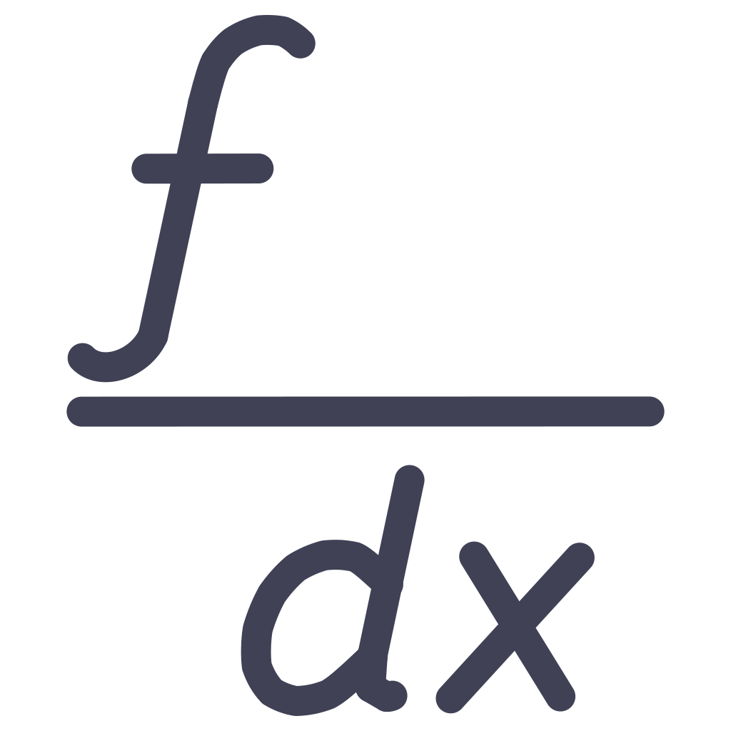

Conclusion
Polynomial Regression Summary
Polynomial regression extends linear regression by modeling the relationship between the independent variable and the dependent variable as an nth-degree polynomial. Its core strength lies in its ability to capture complex, non-linear patterns in data, adapting to various curvatures that linear models cannot. However, choosing the appropriate polynomial degree is crucial; a balance must be struck between flexibility to fit the data and the risk of overfitting, where the model might memorize noise rather than underlying trends.
Importance in Numerical Methods
Polynomial regression is a fundamental tool within the broader field of numerical methods. It plays a significant role in approximating intricate mathematical relationships and functions, allowing for predictions and insights even when the true relationship is unknown or too complex to explicitly define. Its applications span across diverse domains such as science, engineering, and economics, making it an indispensable technique for data scientists, engineers, and researchers who need to model and understand real-world phenomena from observed data.
Why Python is Ideal for Implementation
Python stands out as an ideal language for implementing polynomial regression due to its robust and user-friendly ecosystem. Libraries like NumPy provide efficient numerical operations, Scikit-Learn offers streamlined model building and evaluation, and Matplotlib enables powerful visualization of fitted curves. Python's readability, extensive community support, and comprehensive documentation make it accessible for beginners while providing advanced capabilities for experienced users, facilitating rapid prototyping and deployment of regression models.
Mastering polynomial regression empowers us to uncover hidden patterns and make informed decisions in a data-driven world.
Notes:
14

Slide 15
References
1
2
Books & Textbooks
Academic & Research Articles
"Numerical Methods for Engineers" by Steven C. Chapra and Raymond P. Canale
Polynomial regression in statistical modeling literature
Papers on bias-variance tradeoff and model selection
"Introduction to Statistical Learning" by James, Witten, Hastie, and Tibshirani
Research on overfitting and regularization techniques
"Python for Data Analysis" by Wes McKinney
Studies on applications in engineering and physics
"Machine Learning: A Probabilistic Perspective" by Kevin P. Murphy
3
4
Python Library Documentation
Websites & Online Resources
NumPy: numpy.polyfit() and numpy.poly1d()
Official NumPy documentation (numpy.org)
Scikit-Learn: sklearn.preprocessing.PolynomialFeatures and sklearn.linear_model.LinearRegression
Scikit-Learn documentation (scikit-learn.org)
Stack Overflow and GitHub repositories
Matplotlib: matplotlib.pyplot for visualization
Kaggle datasets and tutorials
SciPy: scipy.interpolate for advanced polynomial operations
Medium articles and data science blogs
These resources are foundational for understanding and implementing polynomial regression. Please consult original sources for proper citation and in-depth information.
Notes:
15

